Slide 1
N8N Workflow
Book Leaf Chatbot

Slide 2
Workflow Overview
This workflow powers an AI assistant that responds to user chat messages. It grounds answers in Book Leaf’s Supabase knowledge base, enforces citations, and appends a confidence score. If confidence is low, it notifies staff and falls back to a human. Alongside this, a separate ingestion pipeline adds new documents from Google Drive into the Supabase database so the AI stays up-to-date.

Slide 3
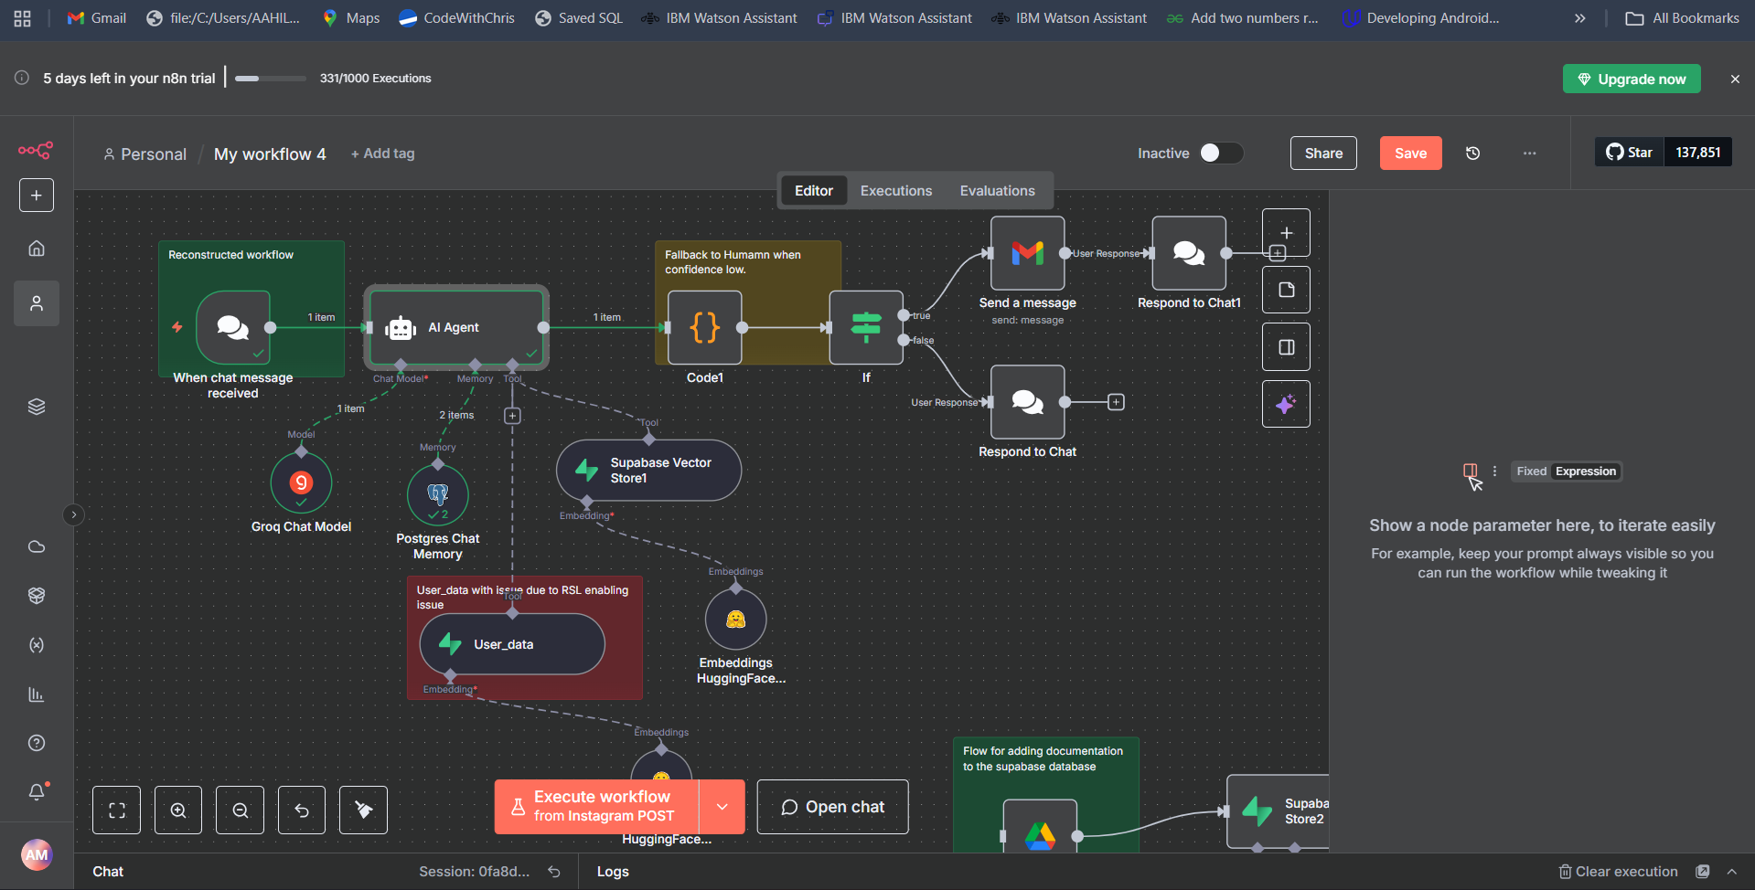
Screenshot of Main Workflow

Slide 4
Flow Explanation
1. Chat Trigger
Workflow starts when a chat message is received.
This is the only active trigger → the chatbot runs only from here.
The UI is provided by the N8N itself
2. AI Agent
Core reasoning engine.
Connected to:
Groq Chat Model (LLaMA-3.1-8B) → generates language output.
Supabase Vector Store → retrieves relevant Book Leaf knowledge.
Postgres Chat Memory → keeps conversation history.
Has a strict system message that enforces rules:
Always query Supabase first.
Only answer from retrieved knowledge.
Cite sources.
End with [CONFIDENCE: XX].

Slide 5
Flow Explanation
3. Function Node
Takes the AI Agent’s output and processes it:
Extracts the [CONFIDENCE: XX] score.
Removes the confidence tag from the response.
Adds a flag needsHuman = true if confidence < 80.
Output includes:
{
"originalResponse": "...raw...",
"cleanResponse": "...user-friendly...",
"confidence": 75,
"needsHuman": true
}
4. Decision Branch (If Node)
Checks the needsHuman flag.
If confidence < 80 (low confidence):
Send a Gmail alert → notifies the human team with details (user question, AI attempt, confidence).
Respond to Chat1 → user is told: “You might get a better answer from a human. Hold on while I connect you…”
If confidence ≥ 80 (high confidence):
Respond to Chat → sends the AI’s clean response back to the user.

Slide 6
Flow Explanation
5. Document Ingestion Flow (separate path)
Google Drive → Download File (Word document).
Recursive Character Splitter → breaks it into chunks.
Hugging Face Embeddings → converts chunks into vector embeddings.
Supabase Vector Store2 → inserts the vectors into the database.
This keeps the chatbot’s knowledge base up-to-date with new documents. 6. Error Workflow
Workflow settings point to an external Error Logger workflow.
If this chatbot workflow crashes (unhandled error), the error logger workflow runs (e.g., logging to Google Sheets).

Slide 7
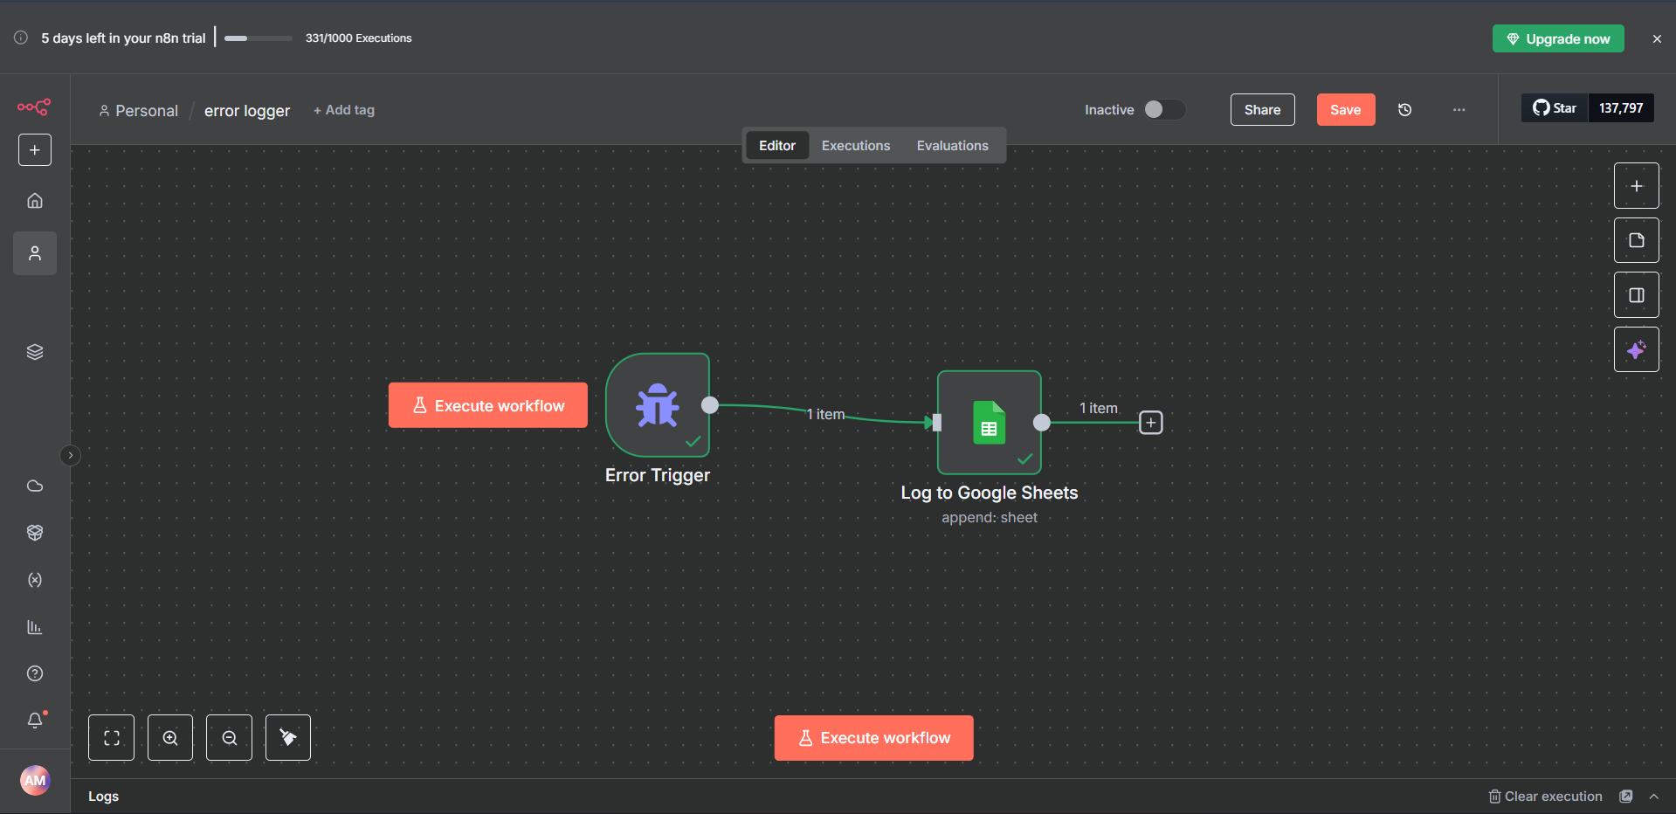
Screenshot of Error Handling workflow

Slide 8
Error trigger Flow Explanation
1. Error Trigger
This node is the starter.
It automatically fires whenever any other workflow in your n8n instance fails during execution.
And it is connected to the main workflow by settings-> Error workflow->Name of your workflow
The trigger captures error context:
Which workflow failed.
The execution ID and URL.
The node where the error happened.
The error message itself.
2. Log to Google Sheets
Takes the error information from the trigger.
Appends a new row to a Google Sheet (error log).
Columns captured:
Timestamp → exact time of error ($now).
Workflow → the name of the workflow that failed ($workflow).
URI → link to the execution in n8n ($json.execution.url).
Node → the node object that threw the error.
Error Message → the error details.

Slide 9
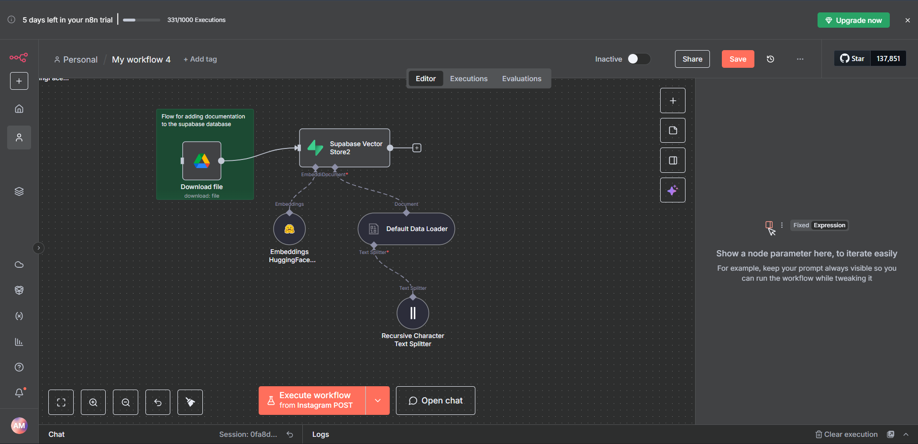
Screenshot of Document insertion into database Workflow

Slide 10
Document insertion Flow Explanation
1. Download file (Google Drive)
Pulls a .docx file from Google Drive (in your case: writting_challange.docx).
This is the entry point: anytime you want to add a new document to your knowledge base, it starts here.
2. Recursive Character Text Splitter
Takes the downloaded document text and splits it into smaller chunks.
Chunks are necessary because embedding models and vector databases work best on manageable text sizes.
This step ensures long documents can be indexed properly.
3. Default Data Loader
Formats the text chunks into a structure that the vector store understands.
Prepares metadata and document references for storage.
4. Embeddings HuggingFace Inference2
Converts each text chunk into a vector embedding using Hugging Face.
These embeddings capture semantic meaning of the text (so the AI can later retrieve relevant answers based on meaning, not just keywords).

Slide 11
Document insertion Flow Explanation
5. Supabase Vector Store2
Stores both the embeddings and the original document chunks into the Supabase database (documents table).
This extends the chatbot’s knowledge base with the new content from the Google Drive file.

Slide 12
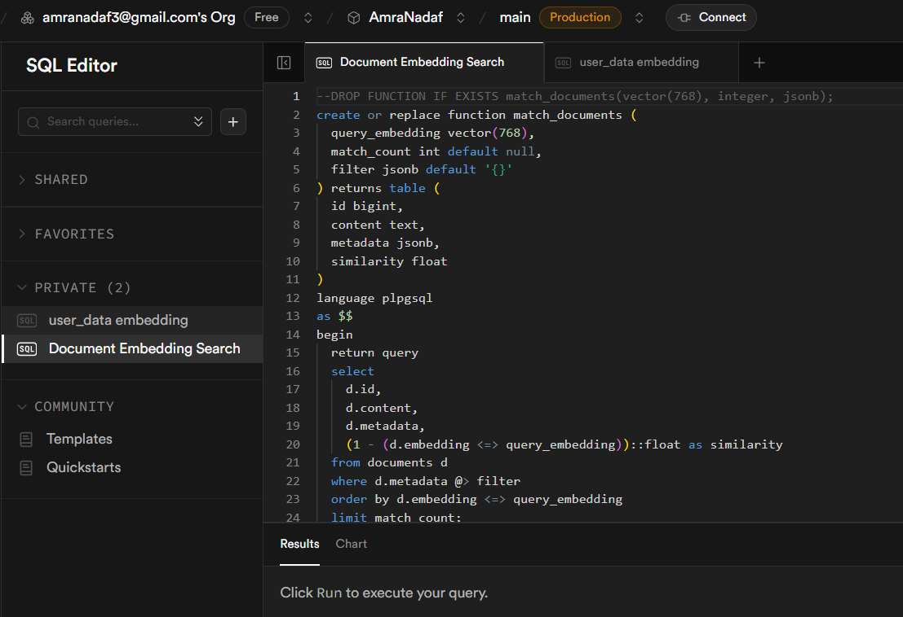
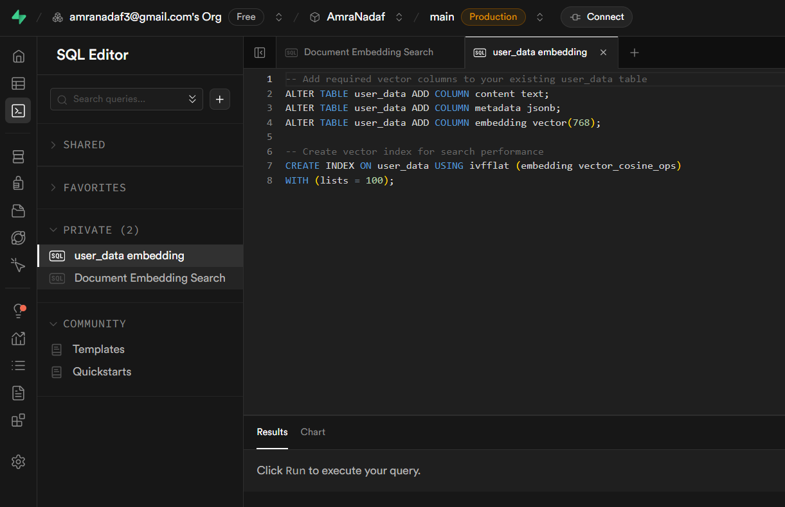
Screenshot of Supabase SQL code

Slide 13
Supabase SQL code
This part of the code is necessary for vectorizing and storing documents in Supabase, so that the system can compare their embeddings with the query embeddings and return or generate the most appropriate response.

Slide 14
Output Screenshots
Smart Email assistant

Slide 15
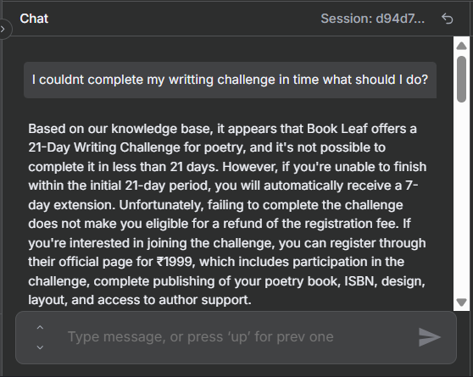
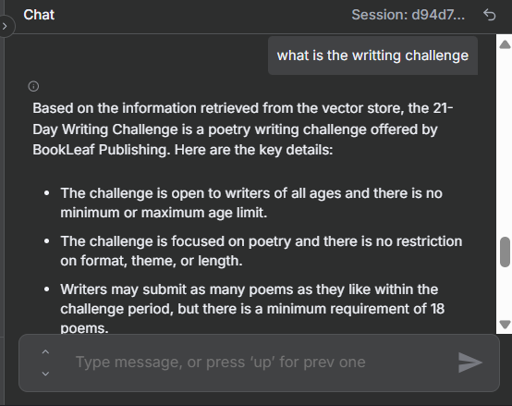
Output of more than 80% confidence query

Slide 16
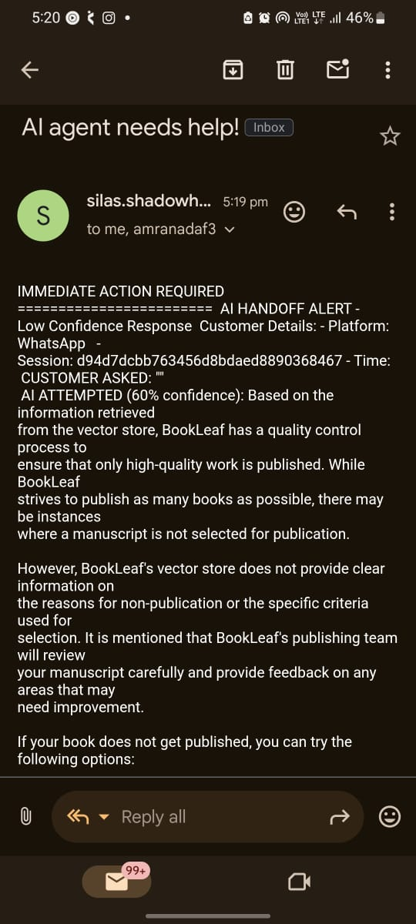
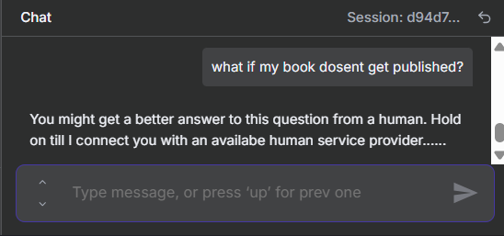
Output of less than 80% confidence query

Slide 17
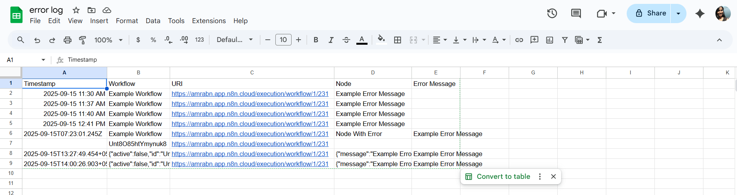
N8N Error trigger flow output

Slide 18
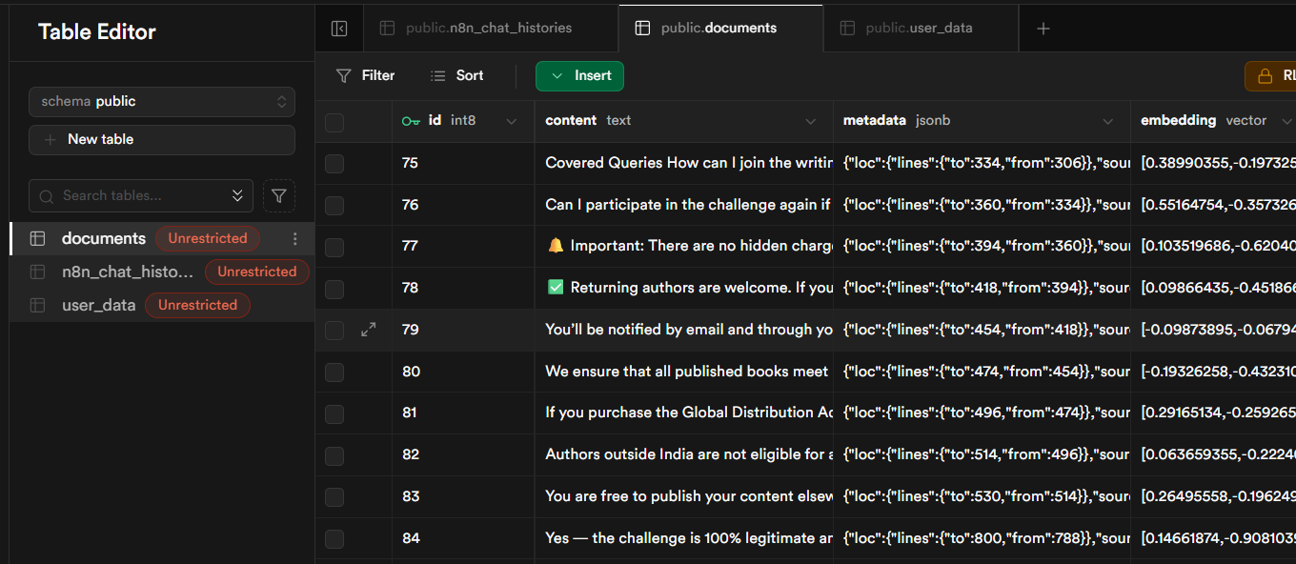
SQL created tables

Slide 19
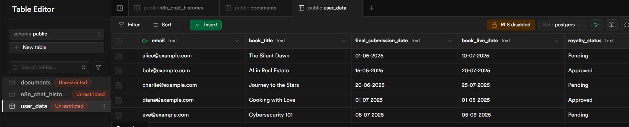
SQL created tables mock supa database

Slide 20
Issues

Slide 21
Potential Issues
1. Mock database integration
The flow previously crashed due to a corrupt JSON file.
I am currently working on diagnosing the root cause and reconnecting this database integration into the workflow.
2. Fallback handling
The current fallback path works, but it could be refined to provide a smoother, more user-friendly experience for customers.
3. Multi-channel support
At the moment, the flow only works through a single chat entry point.
Future improvements could include proper integration of multiple channels (e.g., WhatsApp, Gmail, Instagram).
4. Rate limiting
No rate limit logic is currently implemented.

Slide 22
Thank You!

